Slide 1

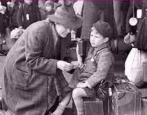
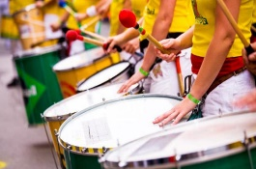

Engage
The children will learn about:
English:
* Books – Crater Lake / children’s choice
* Writing - radio broadcasts, description, narratives and
biographies.
* Reading comprehension - we will continue to develop our comprehension skills.
* Revision of learning so far.
History, Geography & DT: (Continued from Spring 2)
* The causes of World War 2.
* World War 2 timelines and maps.
* Important battles - Dunkirk, the Battle of Britain and D-Day.
* The Blitz, including maps of cities targeted and evacuation locations.
* The Home Front - evacuation, rationing and ‘make do and mend.’
* Local history - the effect of World War 2 on Bedford and Kempston.
* The role of women and other important figures.
* The Holocaust
* VE Day and the end of the war.
Other areas of learning:
Maths:
* Ratio & Proportion * Statistics
* Geometry - 2D & 3D shape * Revision
* Daily Maths starters will cover areas we have already done, as well as helping
children to maintain their confidence with their arithmetic skills.
RE: What helps Hindus as they try to be good?
PSHE: Relationships
COMPUTING: ‘We are Travel Writers’.
MFL: French, taught by Madame Kahler.
PE: Dodgeball and Music: Musician of the Week and Leavers’ Assembly
Rounders preparation.
Develop
What do you know about the Second World War?
How can we learn about the Second World War? Personal stories.
Year 6 - Summer 1
A Child’s War (continued)
The children will consider what they have learned and use it to support their work in English.
They will have opportunities to follow their interests and decide how they would like to present what they learn in other areas.
Express

