Slide 1

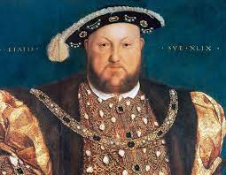
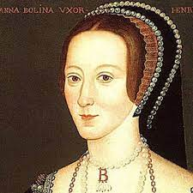


The children will learn
English:
Newspaper Re-counts – Anne Boleyn’s Beheading!
Soliloquys – ‘To be…or not to be!’
Literary Heritage – A Modern Account of Shakespeare!
Class Story: Roof Toppers by Katherine Rundell
Science:
Mixtures and Solutions
Separating Mixtures and Solutions
Exciting Concept Cartoons
Geography:
Ariel Photographs
Changes in a City Over time
ART:
Meet Hans Holbein
Tudor Miniature Portraits
Modelling and Painting a Tudor Rose
Other areas of learning:
Maths:
Decimals
Angles
RE: Faith in Islam
Music: Dancing In The Street – Xylophones
PSHE: French: Computing:
Relationships with Mme Kaler We Are Architects
P.E.: Badminton and Athletics
Engage
Develop
Find out all about Henry VIII and his wives and present your research in a style of your choice!
Year 5 – Summer 1
OFF WITH HER HEAD!
After finding out about the Tudor Monarchs, Henry and his 6 wives, we will delve more deeply into various aspects of Tudor life, including: Tudor London, punishments, fashion and art work! We will be doing various, fun activities such as modelling the Tudor Rose out of clay, re-creating short drama scenes from a Tudor court and painting our very own Tudor miniature portraits!
Express

