Slide 1

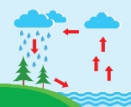


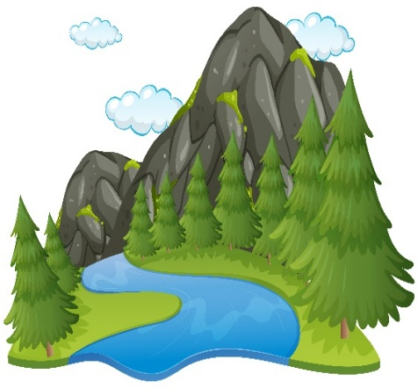


Engage
The children will learn about:
English:
Science:
We will be investigating the Water Cycle.
Geography:
We will be using lots of geography skills this half term. We are finding out about rivers and mountains and how the earth’s landscape can be changed. We will be using ordnance survey maps, learning about water systems and working scientifically to collect and analyse data.
Art & DT:
Looking at landscapes and developing our watercolour skills.
Other areas of learning:
Maths:
We will be learning about decimals, money and time.
RE: Music:
Pentecost We will be studying the charanga unit Blackbird
What is the impact for Christians? which is focused around the song by the Beatles.
PSHE:
Relationships.
We will be looking at the different relationships we have with people in our lives and how we can identify and manage our feelings.
PE:
Outdoor and adventurous activities.
Rounders
Computing:
We are meteorologists.
French:
We are learning new vocabulary and ways to talk about holidays.
Develop
How are mountains made?
Are there different types?
What questions can you ask and what do you want to find out?
Year 4 – Summer 1Misty mountain, Winding river
We will be using everything we have learnt and all our skills on a special trip down to the river!
Express

