Slide 1

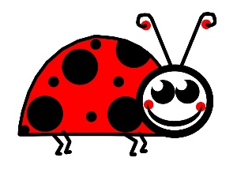


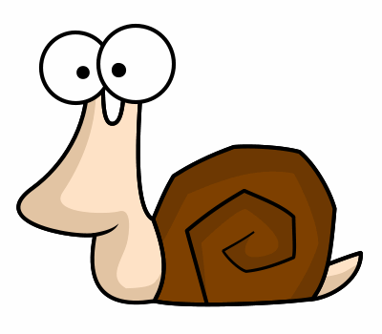
The children will learn about:
English:
Reading comprehensions
Minibeast fact file
Science:
Tree shaking/microhabitats
Survival- what do animals/humans need?
Capture and release
Food chains
Life cycle of a bee
Camouflage and warning colours
Geography:
Sketch maps
Art & DT:
Why do bees make honey?
Making a moving minibeast book (mechanisms)
Other areas of learning:
Maths:
Four operations
Measurement grams/ volume and capacity.
Time (o’clock and half past)
RE: Music:
Who is a Muslim? *Friendship song
What do they believe and how do they live?
PSHE:
Jigsaw – Relationships
PE:
Uni- hoc * Gymnastics/ dance Computing: * We are zoologists.
Engage
Develop
This summer we are going to become explorers and look for a variety of minibeasts. We will look at their habitats and think about what animals need to survive. We will also use tally charts to record the different insects we find whilst using magnifying glasses to observe them closely.
Year 2 –Summer 1 Wriggle and Crawl
We are going to make our own page for a moving minibeast book. We are going to spend some time in our DT lessons exploring different moving mechanisms and then we will design and create our background and the minibeast we would like to move.
Express

