Slide 1

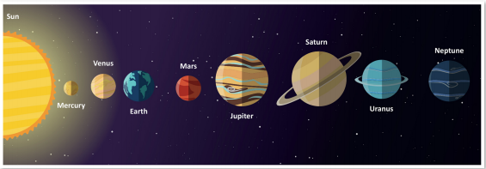
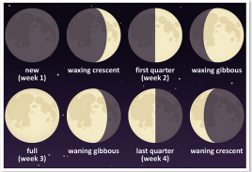
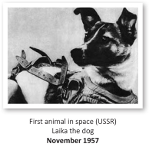
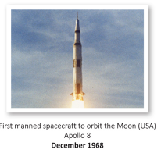

Engage
The children will learn :
English:
* Narrative – Planet Mars and The Mars Rover.
Non-Fiction – Non-Chronological report on a Planet
Class book – Survival in Space – David Long
Science:
The solar system
The planets
Gravity
Phases of the Moon
History:
Isaac Newton
Galileo Galilei
The Space Race
Art:
Space Art inspired by Peter Thorpe
Moon drawings
Other areas of learning:
Maths:
* Factors and Prime Numbers
* Number – Multiplication (x)
Number – Division (÷)
Perimeter and Area
Square and Cub Numbers
RE: Music:
How and why do some people inspire others Classroom Jazz
Fresh Prince of Bel-Air
PSHE: French:
Celebrating Difference Body Parts.
P.E.:
Netball Computing:
Gymnastics We are Cryptographers!
Develop
Planet Investigation – Solar System Models!
Year 5 – Autumn 2
Stargazers
We will investigate our solar system in some detail, looking first at the Sun, the Moon and the Planets. We will look at the order and size of the planets in more detail, as well as the forces at work in our Solar System by conducting investigations into Gravity.
Art – Inspired by Peter Thorpe, we will be producing artwork in the style of this artist.
History – We will be researching and creating reports on key historical figures (Galileo/Newton) and events (Space Race).
Express

